Slide 1
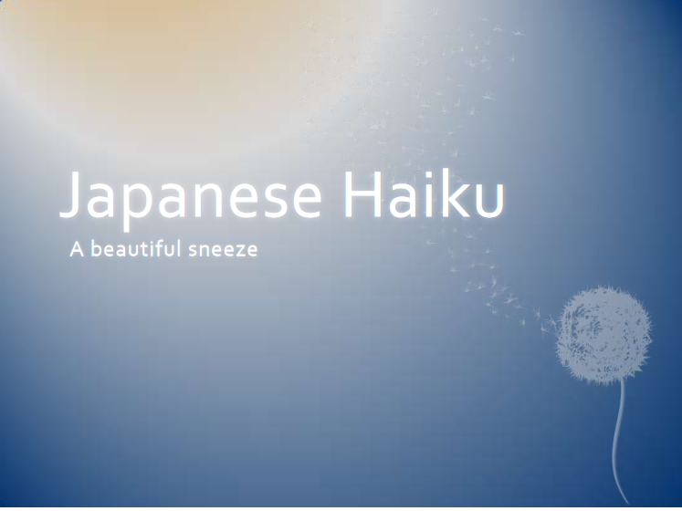
Thomas Moran Jinan University

Slide 2
What is Haiku?
Haiku is a poetic form that originated in Japan hundreds of years ago and continues today.
Haiku reflects many characteristics of the Japanese people such as their appreciation of tradition and their sensitivity to nature.
Haiku is a thoughtful, unrhymed Japanese poem that attempts to capture the essence of a moment in which nature is linked to human life.
As one of the most important forms of traditional Japanese poetry, a well-written haiku creates tension between contrasting elements.
Haiku uses just a few words to capture a moment and create a picture in the reader’s mind. It is like a tiny window into a scene much larger than itself

Slide 3
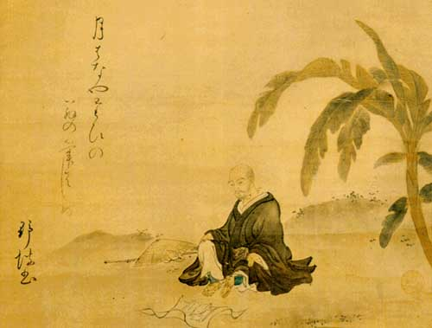
Matsuo Bashō
(1644 -1694)
Haiku originally began as a comic style of verse that was simple to write. But in the late 1600’s, Matsuo Basho changed haiku into a serious art form. His haiku, written according to strict rules, describe subjects in nature and contain a reference to a season of the year. These poems merely suggest ideas and feelings, and so the reader must use imagination to interpret them.

Slide 4
What is a Haiku?
A three line poem with no more than 17 syllables.
Expresses a thought, feeling or a mood, using nature.
Traditionally at least one line must describe or convey
a sense of season, or hour (day or night).
Haiku are also accompanied with a picture to help
guide the reader.
The layout of a Haiku is 5 syllables, 7 syllables, 5
syllables.
To count syllables break the words into parts when you
say it; for example: layoutis two syllables lay-out.
Let’s take a look at a few Haiku’s

Slide 5
Showing no sign of an early death— a cicada’s voice
—Matsuo Basho
Under the tree in the soup, salad, and everywhere— cherry blossoms
—Matsuo Basho

Slide 6
A lightning flash— and piercing the darkness a heron’s shriek
—Matsuo Basho
A giant firefly flickers and then moves on
—Kobayashi Issa

Slide 7
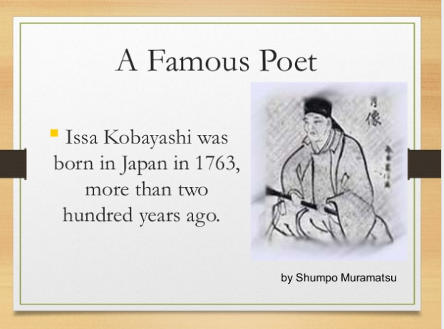

Slide 8
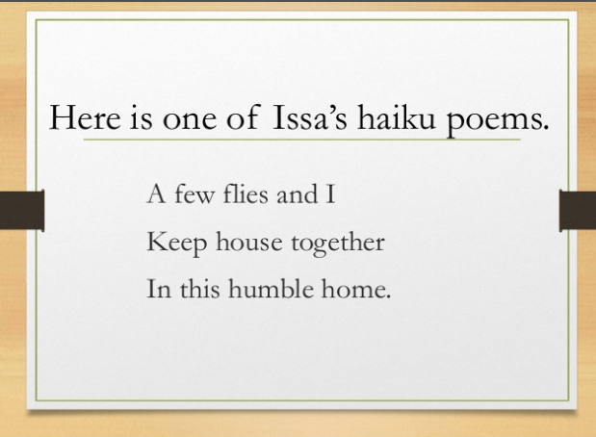

Slide 9
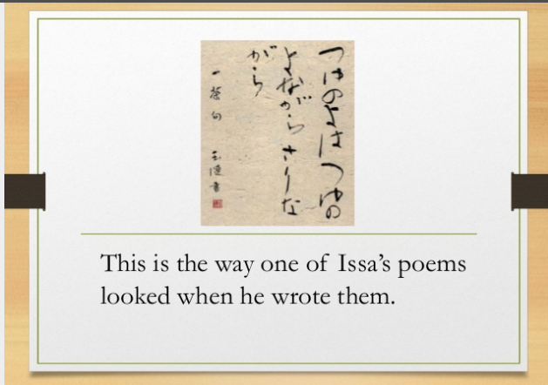

Slide 10
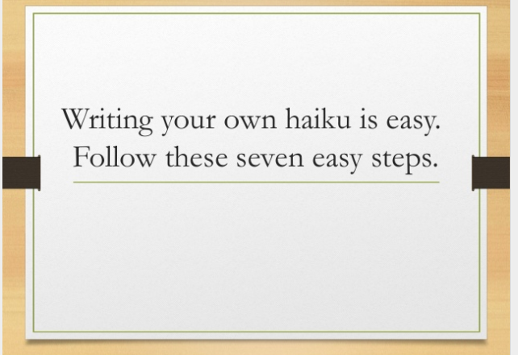

Slide 11
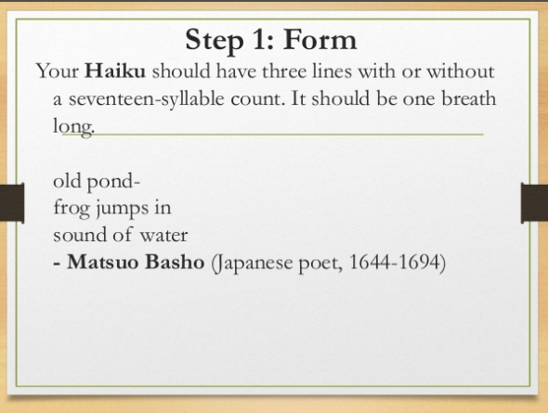

Slide 12
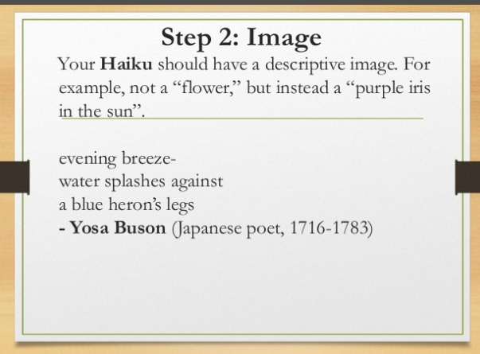

Slide 13
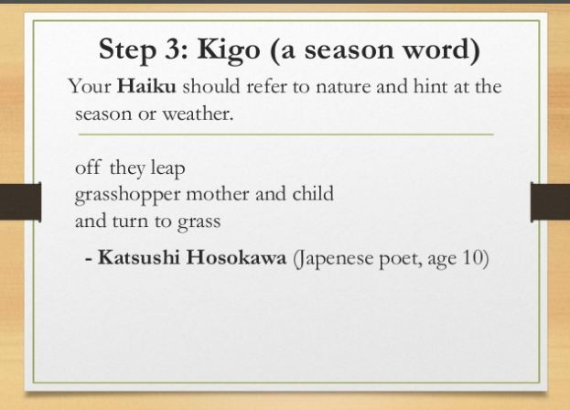

Slide 14
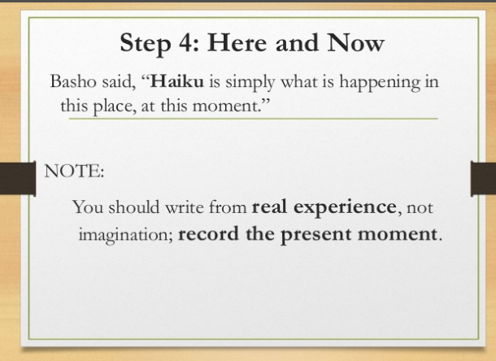

Slide 15
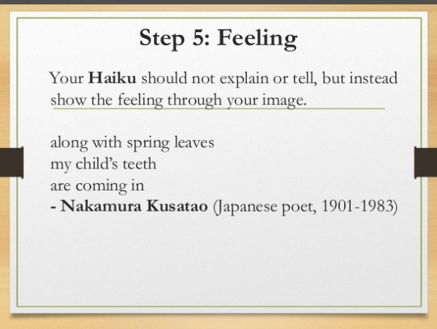

Slide 16
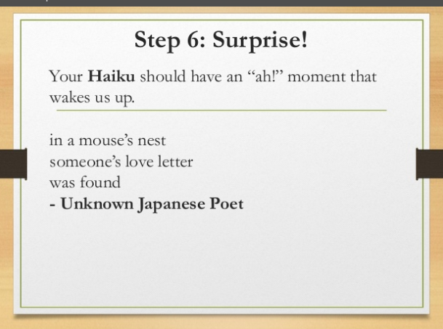

Slide 17
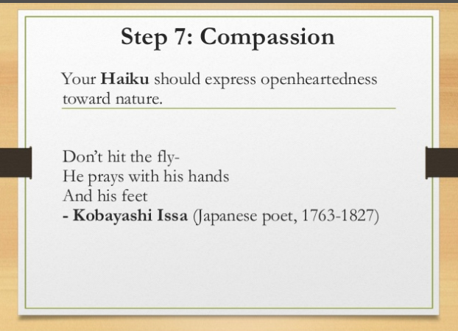

Slide 18
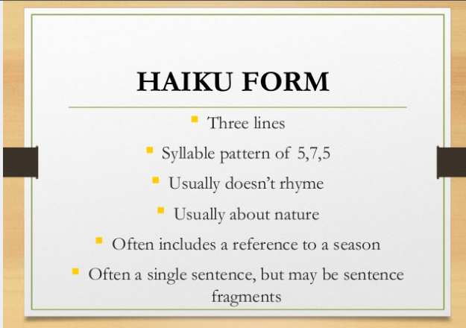

Slide 19
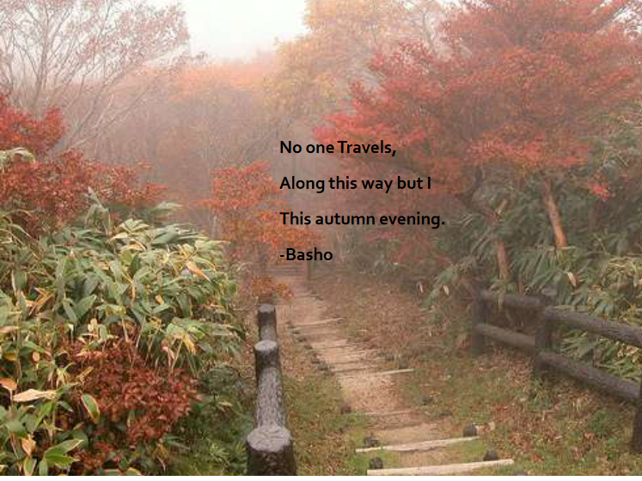

Slide 20
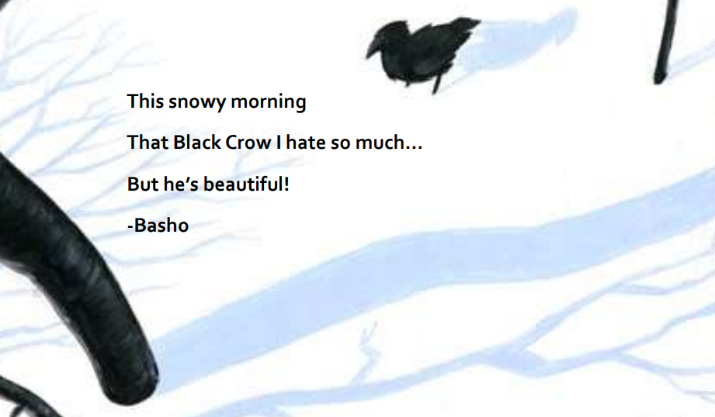

Slide 21
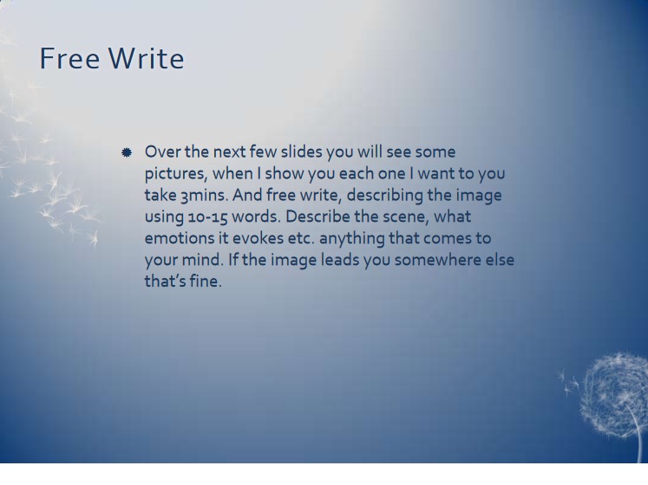

Slide 22
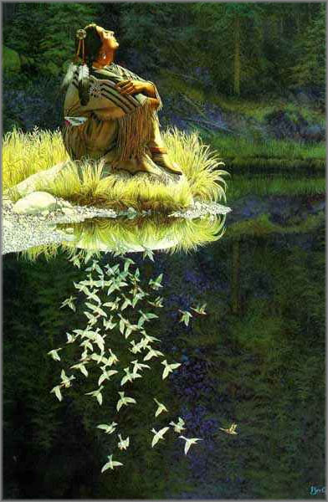

Slide 23
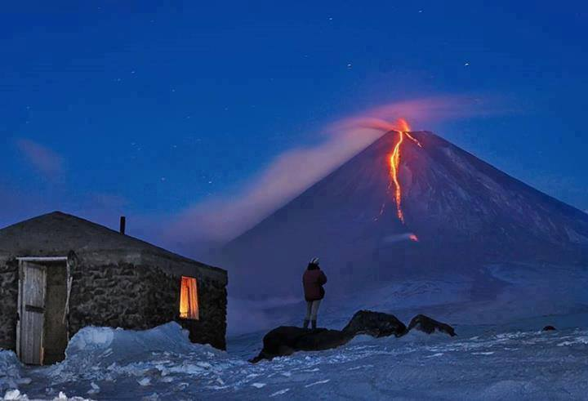

Slide 24
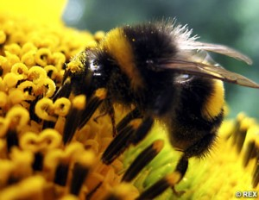

Slide 25
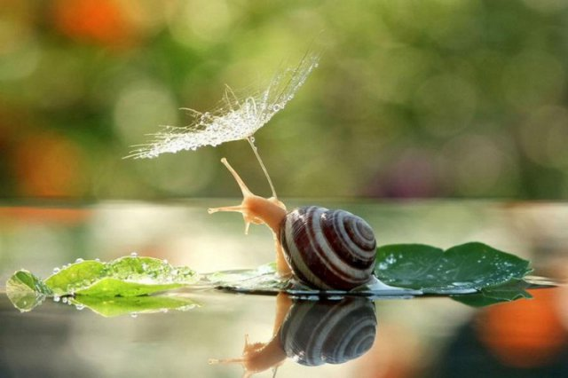

Slide 26
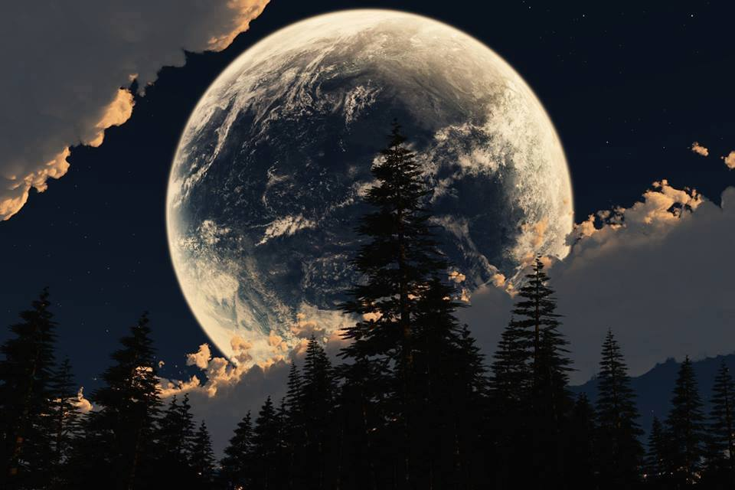

Slide 27
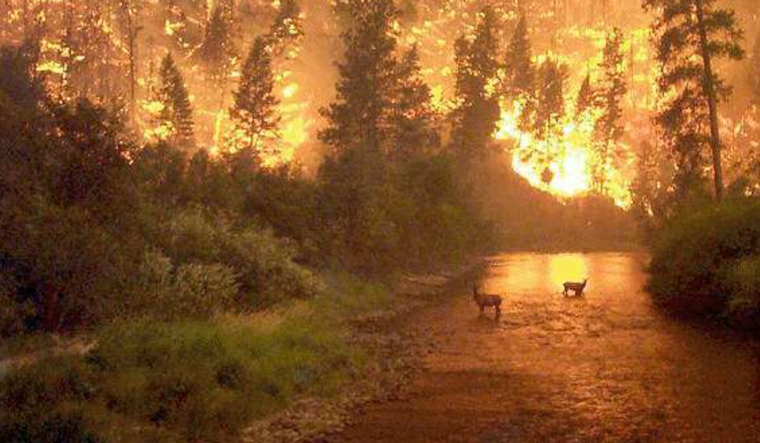

Slide 28
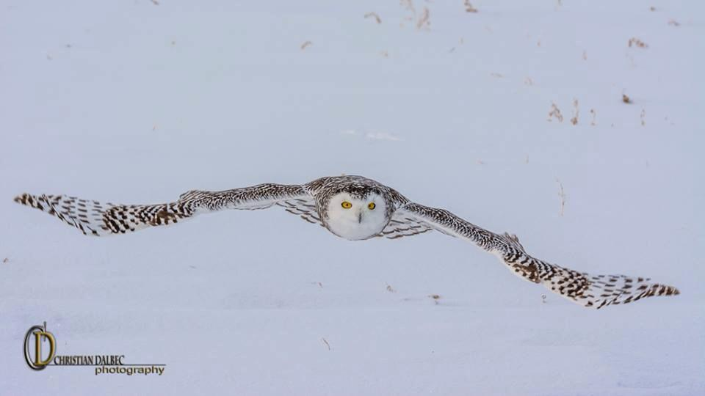

Slide 29


Slide 30
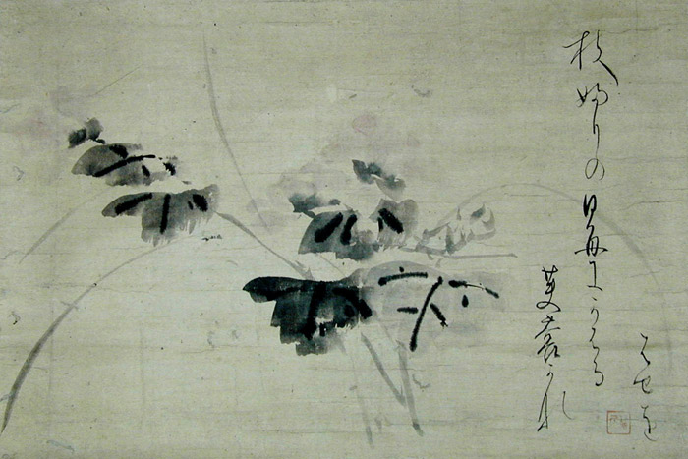
Writing Haiku
for Peace or as Protest

Slide 31
Haiku as Protest
Many people have written haiku as a way of protesting against war and as a means of expressing their wishes for peace. Rick Black lived in Israel when he wrote the following haiku. He used the haiku medium as a means of conveying the stark images “of peace and war, of hope and fear – and the way they blend together”.
purple bougainvillea
beyond the barbed wire
flowering wildly
—Rick Black

Slide 32
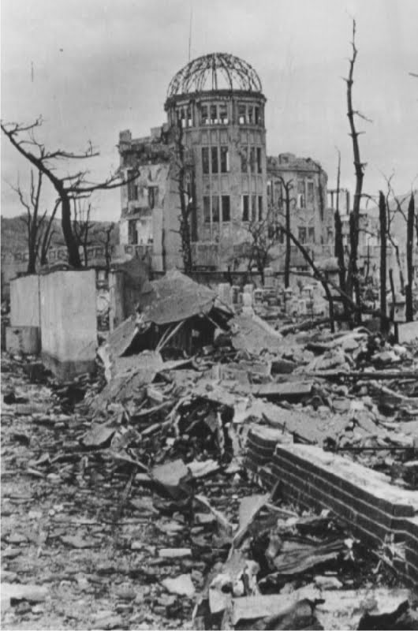
so joyously,
a pair of doves flirting over
a soldier's gravestone
—Rick Black
rainbow's arc
the old city's domed rooftops
still glistening
—Rick Black

Slide 33
Haiku for Peace
a hornet asleep
maybe peace looks different
than I thought it did
—KD, 23rd July 2013

Slide 34
though war is
old is has not
become wise …
—Alice Walker, 23rd August 2012
Grandmothers, mothers
daughters, each generation
chants a hymn of hope
—Debjani Chatterjee, 23rd August 2012

Slide 35
The sprawling sound
of peace sails on the wind
A white butterfly
—Sonia Sanchez, 23rd August 2012

Slide 36
Student’s Haiku for Peace and as Protest
Destruction surrounds
Tears and screams are shouted out
No one understands.
— Katarina
Imagine a world
With no sorrow or death
And no more crying
—Sana

Slide 37
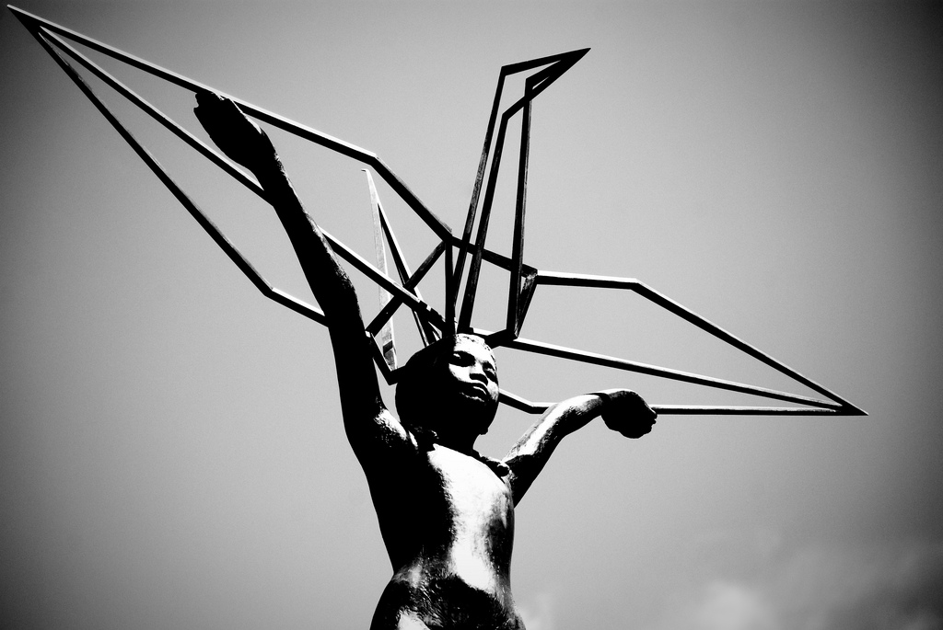
I will write peace
on your wings and you will fly,
all over the world
—Sadako Sasaki

